Slide 1
what is photo booth rental
https://sites.google.com/view/roamingboothorangecounty/home
Notes:
https://drive.google.com/file/d/1rzVJtgO1phW3vGqOEPcuIkmVkYS9pJNc/view?usp=sharing
https://drive.google.com/file/d/1pRu3HtSojUb-5CQuxqmEdIRK60TTzyT6/view?usp=sharing
https://drive.google.com/file/d/1BAnY01WXfJq5fexiORKdN9P3ORIr_lNc/view?usp=sharing
https://docs.google.com/document/d/16Z5WOgN_S0ZxdAKRAbudKJHasgQI56U_aBQ9yBUrYfQ/edit?usp=sharing
https://docs.google.com/document/d/16Z5WOgN_S0ZxdAKRAbudKJHasgQI56U_aBQ9yBUrYfQ/pub
https://docs.google.com/document/d/16Z5WOgN_S0ZxdAKRAbudKJHasgQI56U_aBQ9yBUrYfQ/view
https://docs.google.com/presentation/d/1lBprUWJyH2H-yrIC2I30r62Z0NGuldT-Ev9OusjNelc/edit?usp=sharing
https://docs.google.com/presentation/d/1lBprUWJyH2H-yrIC2I30r62Z0NGuldT-Ev9OusjNelc/pub?start=true&loop=true&delayms=3000
https://docs.google.com/presentation/d/1lBprUWJyH2H-yrIC2I30r62Z0NGuldT-Ev9OusjNelc/view
https://docs.google.com/presentation/d/1lBprUWJyH2H-yrIC2I30r62Z0NGuldT-Ev9OusjNelc/htmlpresent
https://docs.google.com/document/d/1kh0rzwGCA-IoXqfwFvVnlOKbMkmi86vj3uD-FDUK4sc/edit?usp=sharing
https://docs.google.com/document/d/1kh0rzwGCA-IoXqfwFvVnlOKbMkmi86vj3uD-FDUK4sc/pub
https://docs.google.com/document/d/1kh0rzwGCA-IoXqfwFvVnlOKbMkmi86vj3uD-FDUK4sc/view
https://docs.google.com/presentation/d/11-KBCkS6l9LDB8mTS3VLyKk6ySRZB75YEcn0OhmAiuw/edit?usp=sharing
https://docs.google.com/presentation/d/11-KBCkS6l9LDB8mTS3VLyKk6ySRZB75YEcn0OhmAiuw/pub?start=true&loop=true&delayms=3000
https://docs.google.com/presentation/d/11-KBCkS6l9LDB8mTS3VLyKk6ySRZB75YEcn0OhmAiuw/view
https://docs.google.com/presentation/d/11-KBCkS6l9LDB8mTS3VLyKk6ySRZB75YEcn0OhmAiuw/htmlpresent

Slide 4
what is photo booth rental
Make an event that everyone will remember and enjoy for years, and the Vogue Photo Booth makes for a dynamic environment where a futuristic light display will bring out your inner supermodel. Pose for the camera with our Light Tunnel Vogue Photo Booth Rental, The Standard Vogue Photo Booth Package comes with a digital only experience, and you can choose to add-on printing at an additional cost. Make your visitors feel like they're on the runway by striking a pose in our Vogue Photo Booth, the most technologically advanced photo booths in Los Angeles and Orange County.
https://sites.google.com/view/roamingboothorangecounty/home
Notes:
photo booth rentals for weddings,what is photo booth rental,in the booth photo booth hire

Slide 5
Contact Information
Lucky Frog Photo Booth | 360 Video Booth Rental Los Angeles
532 S Olive St, Los Angeles, CA 90013
562-303-9926
Notes:
Lucky Frog Photo Booth | 360 Video Booth Rental Los Angeles532 S Olive St, Los Angeles, CA 90013562-303-9926

Slide 6
More info about us:
photo booth rentals for weddings
what is photo booth rental
in the booth photo booth hire
Notes:
Lucky Frog Photo Booth | 360 Video Booth Rental Los Angeles532 S Olive St, Los Angeles, CA 90013562-303-9926

Slide 7
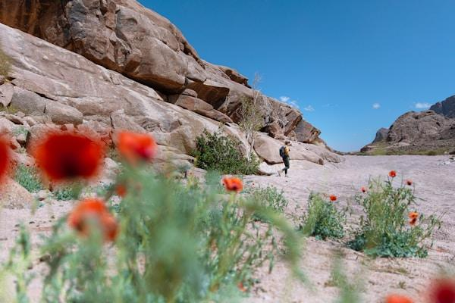

Slide 8
Links
List of recommended resources
Notes:
photo booth rentals for weddings,what is photo booth rental,in the booth photo booth hire

Slide 9
Please visit :
photo
photo
photo
document
document pub
document view
presentation
presentation pub
presentation view
presentation html
document
document pub
document view
presentation
presentation pub
presentation view
presentation html
Notes:
https://drive.google.com/file/d/1rzVJtgO1phW3vGqOEPcuIkmVkYS9pJNc/view?usp=sharing
https://drive.google.com/file/d/1pRu3HtSojUb-5CQuxqmEdIRK60TTzyT6/view?usp=sharing
https://drive.google.com/file/d/1BAnY01WXfJq5fexiORKdN9P3ORIr_lNc/view?usp=sharing
https://docs.google.com/document/d/16Z5WOgN_S0ZxdAKRAbudKJHasgQI56U_aBQ9yBUrYfQ/edit?usp=sharing
https://docs.google.com/document/d/16Z5WOgN_S0ZxdAKRAbudKJHasgQI56U_aBQ9yBUrYfQ/pub
https://docs.google.com/document/d/16Z5WOgN_S0ZxdAKRAbudKJHasgQI56U_aBQ9yBUrYfQ/view
https://docs.google.com/presentation/d/1lBprUWJyH2H-yrIC2I30r62Z0NGuldT-Ev9OusjNelc/edit?usp=sharing
https://docs.google.com/presentation/d/1lBprUWJyH2H-yrIC2I30r62Z0NGuldT-Ev9OusjNelc/pub?start=true&loop=true&delayms=3000
https://docs.google.com/presentation/d/1lBprUWJyH2H-yrIC2I30r62Z0NGuldT-Ev9OusjNelc/view
https://docs.google.com/presentation/d/1lBprUWJyH2H-yrIC2I30r62Z0NGuldT-Ev9OusjNelc/htmlpresent
https://docs.google.com/document/d/1kh0rzwGCA-IoXqfwFvVnlOKbMkmi86vj3uD-FDUK4sc/edit?usp=sharing
https://docs.google.com/document/d/1kh0rzwGCA-IoXqfwFvVnlOKbMkmi86vj3uD-FDUK4sc/pub
https://docs.google.com/document/d/1kh0rzwGCA-IoXqfwFvVnlOKbMkmi86vj3uD-FDUK4sc/view
https://docs.google.com/presentation/d/11-KBCkS6l9LDB8mTS3VLyKk6ySRZB75YEcn0OhmAiuw/edit?usp=sharing
https://docs.google.com/presentation/d/11-KBCkS6l9LDB8mTS3VLyKk6ySRZB75YEcn0OhmAiuw/pub?start=true&loop=true&delayms=3000
https://docs.google.com/presentation/d/11-KBCkS6l9LDB8mTS3VLyKk6ySRZB75YEcn0OhmAiuw/view
https://docs.google.com/presentation/d/11-KBCkS6l9LDB8mTS3VLyKk6ySRZB75YEcn0OhmAiuw/htmlpresent

Slide 10
what is photo booth rental
https://sites.google.com/view/roamingboothorangecounty/home
Notes:
photo booth rentals for weddings,what is photo booth rental,in the booth photo booth hire

